Slide 1

Cross-Platform Native User Interfaces with Xamarin.Forms
Notes:
Welcome, today we are going to talk about Smart app with Xamarin and Azure! We are going to touch the Cognitive service api’s and we’ll see the power that they hold. But before we start.

Slide 2

Who is this guy?
Maurits van Beusekom
@mvanbeusekom
maurits@vnbskm.nl
github.com/mvanbeusekom

Slide 3

Progress is teamwork

Slide 4
Meet Xamarin.Forms
Build native UIs for iOS, Android, and Windows
from a single, shared C# codebase.

Slide 5

Xamarin + Xamarin.Forms
iOS C# UI
Android C# UI
Windows C# UI
Shared UI Code
Shared C# Backend
Shared C# Backend
Traditional Xamarin Approach
With Xamarin.Forms: More code-sharing, all native

Slide 6
What’s included
✓ 40+ Pages, layouts, and controls
(Build from code behind or XAML)
✓ Two-way data binding
✓ Navigation
✓ Animation API
✓ Dependency Service
✓ Messaging Center
Shared UI Code
Shared C# Backend

Slide 7

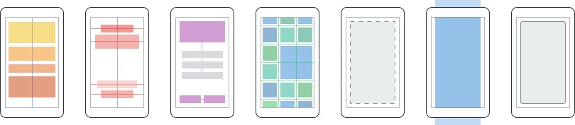
Layouts
Pages
Content
MasterDetail
Navigation
Tabbed
Carousel
Stack
Absolute
Relative
Grid
ContentView
ScrollView
Frame
Notes:
Inside of a page are layouts
A lot of options from something simple like a stack panel to complex and powerful grids

Slide 8
Controls
ActivityIndicator
BoxView
Button
DatePicker
Editor
Entry
Image
Label
ListView
Map
OpenGLView
Picker
ProgressBar
SearchBar
Slider
Stepper
TableView
TimePicker
WebView
EntryCell
ImageCell
SwitchCell
TextCell
ViewCell
Notes:
You have more than 40 controls, layouts, and pages to mix and match from.
These are all of the controls you have out of the box, you can of course create your own.
What is unique is you get the native control and have access to it.
Consider an Entry Field
On iOS it is mapped to UITextField
Android it is EditText
Windows Phone it is a TextBox

Slide 9


Xamarin.Forms Ecosystem

Slide 10
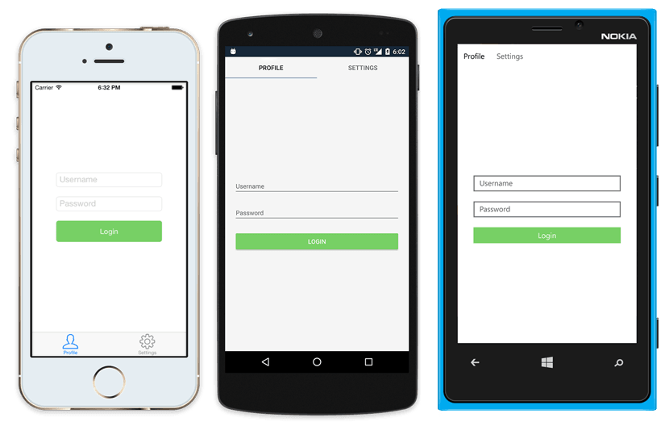
Native UI from shared code
<?xml version="1.0" encoding="UTF-8"?>
<TabbedPage xmlns="http://xamarin.com/schemas/2014/forms"
xmlns:x="http://schemas.microsoft.com/winfx/2009/xaml"
x:Class="MyApp.MainPage">
<TabbedPage.Children>
<ContentPage Title="Profile" Icon="Profile.png">
<StackLayout Spacing="20" Padding="20"
VerticalOptions="Center">
<Entry Placeholder="Username"
Text="{Binding Username}"/>
<Entry Placeholder="Password"
Text="{Binding Password}"
IsPassword="true"/>
<Button Text="Login" TextColor="White"
BackgroundColor="#77D065"
Command="{Binding LoginCommand}"/>
</StackLayout>
</ContentPage>
<ContentPage Title="Settings" Icon="Settings.png">
<!-- Settings -->
</ContentPage>
</TabbedPage.Children>
</TabbedPage>

Slide 11
Xamarin.Forms Demo

Slide 12
Latest and Greatest in Xamarin.Forms

Slide 13
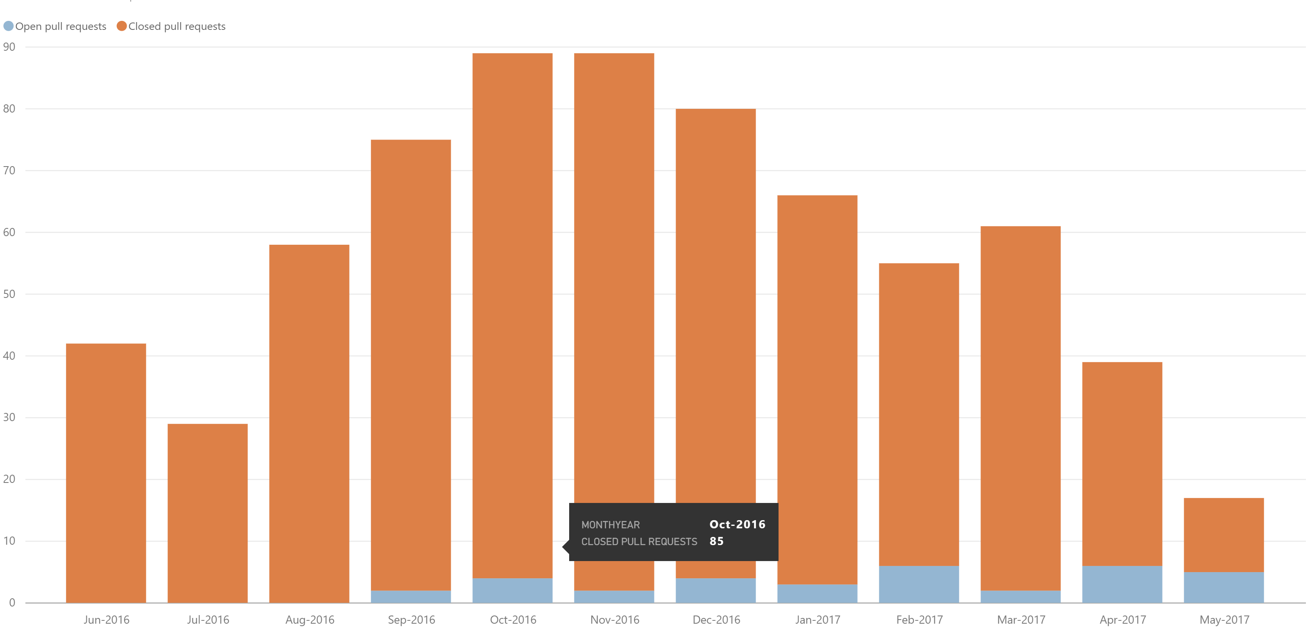
Community
Public Roadmap: aka.ms/xfroadmap
112 contributors
1180 merged pull requests
Notes:
We have created a full public roadmap and crafting it with your help.
Tons of merged PRs and tons of contributors! We love it!

Slide 14
Features and Enhancements
Fast Renderers Preview
Memory Improvements
Native Control Binding
Bindable Picker
Map Extensibility
Startup Time
XAMLC
Forms Previewer
Android Support Libraries
FlexLayout Preview
Frame Corners
Enhanced GestureRecognizers
Tizen
Blur Behind
macOS Preview
Themes
ListView Scrolling
Embedded Native Controls
Deep Linking
.netstandard support
Styles
Fast Scroll
Xamarin.Forms Embedding
NavigationPage Translucency
Accessibility
PlatformSpecifics
Partial Collapse MasterPage
DataPages
Notes:
We have also added a plethora of amazing new features!

Slide 15

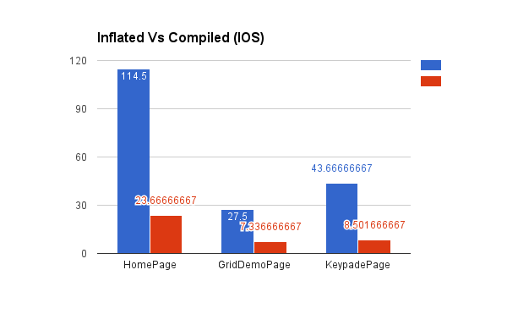
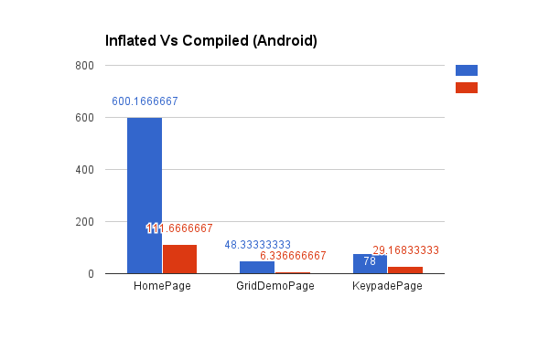
Quality and Performance
Aggressive bug triage
New issues reviewed within 24 hrs
Reproduction projects for quick resolution
Performance Improvements
Startup Time
Fast Renderers for Android
ListView improvements, Fast Scroll
XAMLC – 5x faster
Discussion: aka.ms/xfperformance
Source: Matthew Robbins - MFractor

Slide 16
The Future: Xamarin.Forms 3.0
Notes:
On the horizon of course is 3.0! With great new features

Slide 17
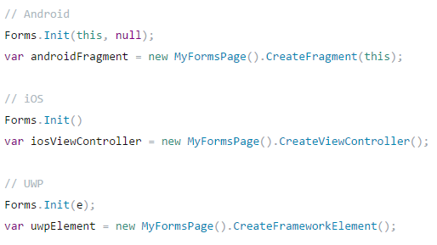
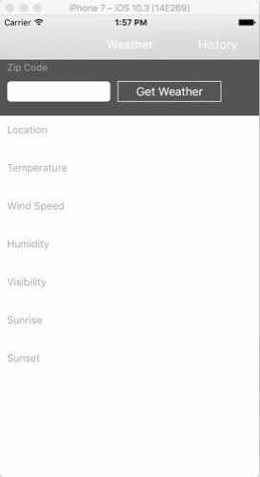
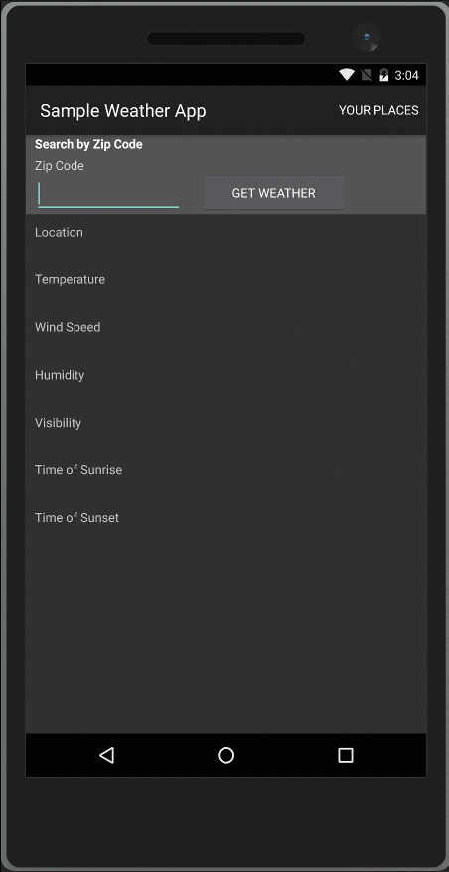
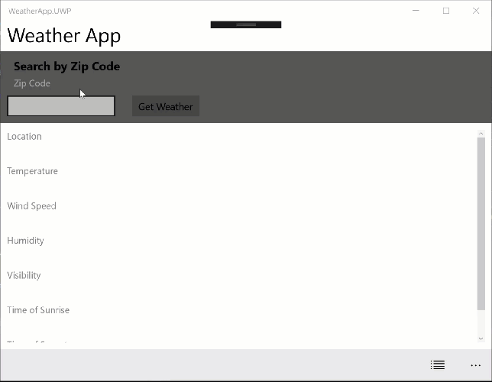
Xamarin.Forms Embedding
Easily embed any page into a Xamarin Native Application

Slide 18
Speed Boosts and Enhancements
Control Renderers: refactored renderers to achieve better performance
Layout Compression: optimize layout at compile time
Binding System: introducing one-time binding mode
Flexibility: FlexLayout system for building adaptive layouts
Styling: CSS-inspired styling implementation
Notes:
Ask audience if they know what flexbox is
Ask audience if they LIKE flexbox

Slide 19

New Platforms
Samsung Tizen
Televisions, Wearables, Mobile
macOS
WPF
Linux: GTK#
Notes:
At the end of talking through this, I’ll do a quick intro of Jason and call him up to demo.

Slide 20
Introducing XAML Standard
One standard for Windows (UWP, WPF) and Xamarin.Forms
XAML Standard 1.0 available later this year
Notes:
Ask audience if they know what flexbox is
Ask audience if they LIKE flexbox

